Slide 1
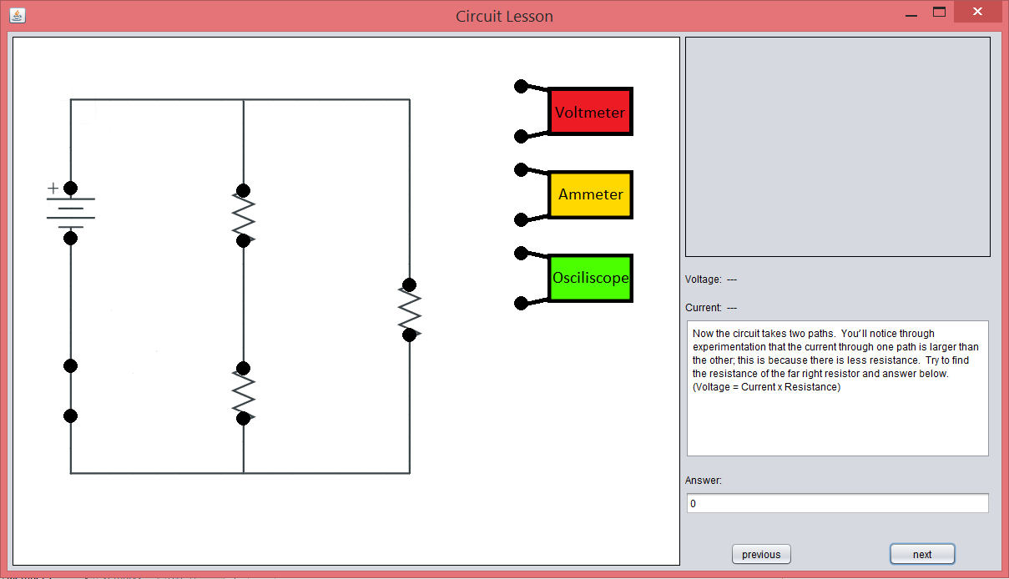
Circuit analysis Lesson
By: Andrew Krause, Mitch Babej, and John Merkel

Slide 2
Features:
Teaches basic measuring concepts
Introduces many basic circuit concepts, including Ohms law and resistor analysis
Engages users with simple click and drag mechanics
Allows for individual exploration of many features of each circuit

Slide 3
Pros:
Cons:
More circuits may be added with relative ease
A lot of information may be discovered from each circuit
It is easy for teachers to elaborate on different elements of the circuits
Could perhaps be more exciting
Only one question per circuit

